Slide 1
xPlorer Plugin Demo
Author: John Kang
Notes:
Todo List:
Look at performance run of set events
One thing I still don’t know is why only one of the Starter’s show up with my logic there should be two with different hexvalues, one for cmd idx and one for fflba

Slide 2
Summer Goal
Develop a mechanism to measure drive performance including IOP/s and QOS
Also provide a method of debugging the events of the drive if there are dips in performance.

Slide 3
Purpose
“Explorer filter on steroids” – Matt
To analysis performance of the drive
Give QOS by measuring the time each command takes.
To link events to allow for more efficient debugging
Grouping SET events and outputting to a CSV file
Counting number of SET events
Sequential SET events (events that don’t have matching parameters)
FE
FTL
PS
Flow suspend
Cmdidx not linked to VBA

Slide 4
Limitations
What SET events actually exist
Data loss from informer
Considerations/Difficulties:
SET events don’t have a universal syntax structure

Slide 5
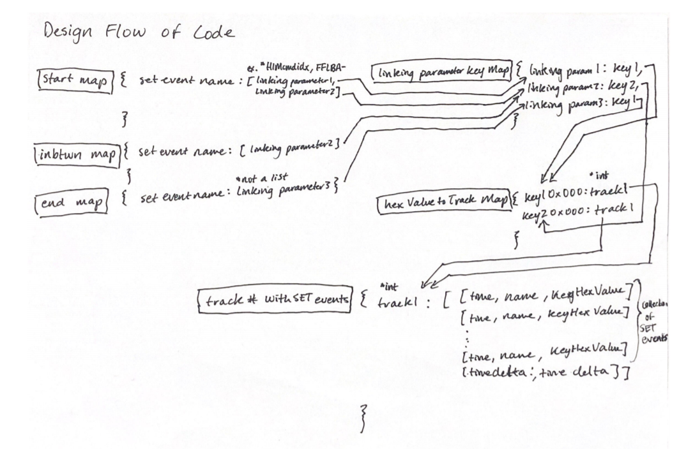
Script logic: QOS
Notes:
Use an example

Slide 6
Script logic: Counter
Checking how many times an event occurs within one command
Map of event name to integer
If an event name is encountered with the same hex value, increase counter
If new hex value is found add a new entry into map with counter at 1

Slide 7
Script: Sequential
Certain events while they are related don’t have parameters that the script can use to link them
The sequential logic follows a simple pattern that the follower events related to the leader occur before a new leader event is seen
Leaders are mapped to a group of related SET events
Followers are mapped to leaders (then to the group)
Leader updates when a new leader event is met. (using hex value)

Slide 8
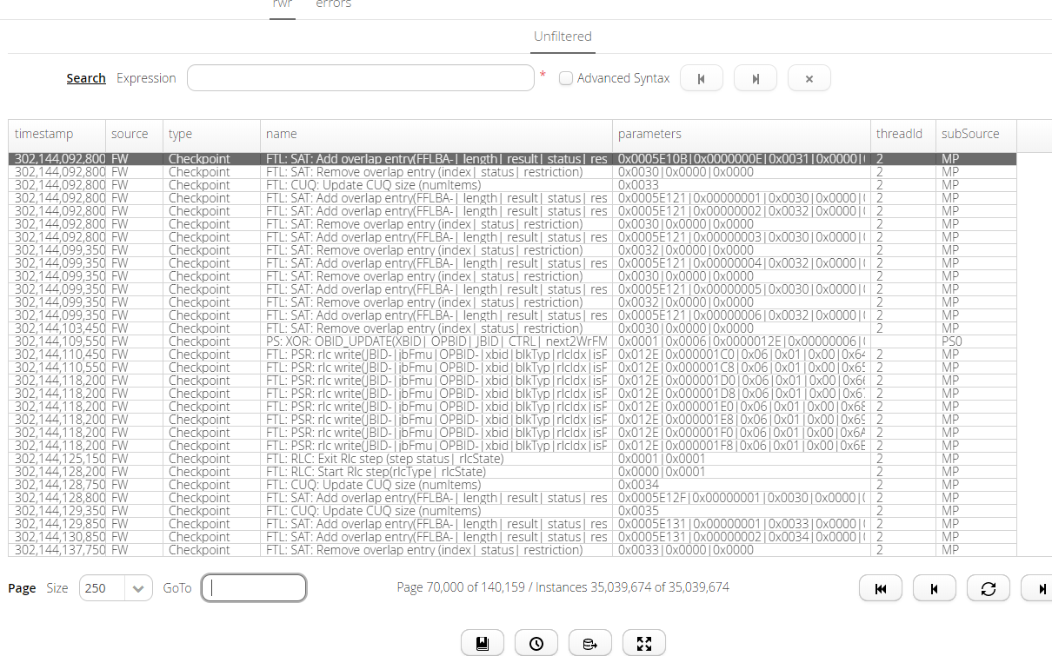
James’ SET events

Slide 9
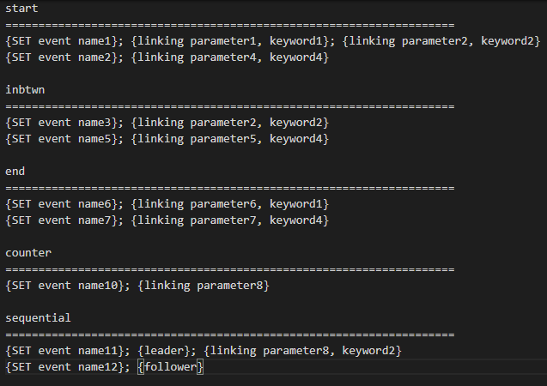
Configuration Template
{} indicate start and end of a phrase
There one event that this doesn’t work with
; separates each phrase
Keyword, like start and end, indicates a new section
Read in using FileReader and string manipulation

Slide 10
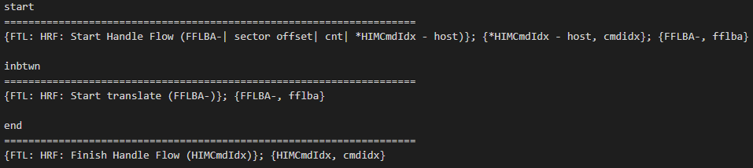
Configuration file tutorial: QOS
Start event: FTL: HRF: Start Handle Flow (FFLBA-| sector offset| cnt| *HIMCmdIdx - host)
In between event: FTL: HRF: Start translate (FFLBA-)
End event: FTL: HRF: Finish Handle Flow (HIMCmdIdx)
Keywords to look for: cmd idx, fflba

Slide 11

Configuration file tutorial: Counter
Counter events: <FTL: HRF: Flow suspend (FFLBA-| Ctxt-| *HIMCmdIdx - host read only)>, <PS: OTG: Host Read Transfer (Cmd Idx| Cmd Off| reqId| vba| DeVBA0| DeVBA1)>
Linking parameter: FFLBA-, Cmd Idx

Slide 12

Configuration file tutorial: Sequential
Leader event: FTL: SAT: Translate direct (FFLBA| Length| SearchCuq)
Follower event: FTL: HRF: Finish translate (FFLBA|JBA|FMUsCnt|*prftch done|*preload cline)
Parameter to connect to original: fflba
Extra: can set max result as 10
Notes:
<FTL: SAT: Translate direct (FFLBA| Length| SearchCuq)>& <leader>& <FFLBA, fflba>
<FTL: HRF: Finish translate (FFLBA|JBA|FMUsCnt|*prftch done|*preload cline)>& <follower>

Slide 13
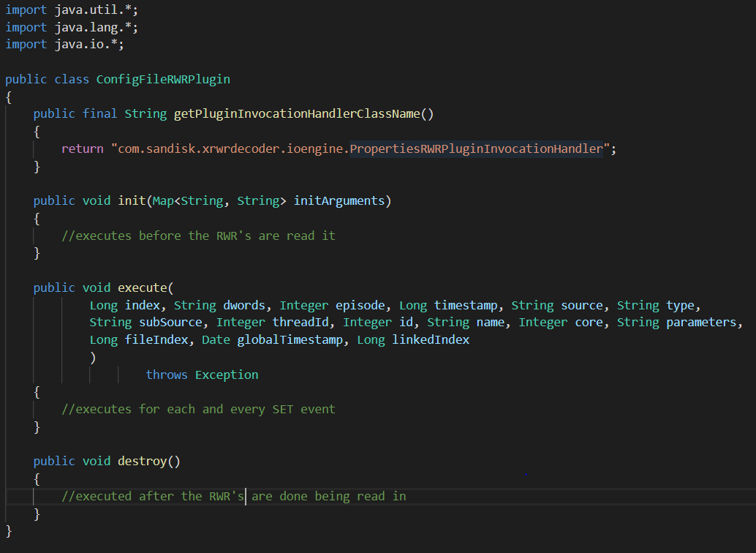
Java Plugin Code Template
Init
Logic performed before the RWR files are read
Execute
The logic here will execute on every SET event read in
Destroy
Logic here will execute after all the RWR files are read
Like any Java Class, helper functions and methods can be added to help with logic

Slide 14
xPlorer CLI tutorial
Running Session Live
File Path to CMD: C:\xTools\app\xplorer\
START: xplorer-cli.bat session create --session-configuration-file=<path to json configuration file> --start=true (*need JSON configuration file)
STOP: xplorer-cli.bat session stop --session-id=<session-id>
Already have RWR files from GUI
File Path to CMD: C:\xTools\app\xrwrdecoder\
START: xrwrdecoder-cli.bat process decode
--product=<product name> --run-mode=READ
--rwr-path<path where RWR files are> --dco-path=C:\RWR\SetDictionary.dco
--output-type=NONE
--plugin-classes=<name of plugin class> --plugin-source-directory=<folder of plugin>
Notes:
xrwrdecoder-cli.bat process decode --product=Calypso-X --run-mode=READ --rwr-path=C:\xTools\RWR\408\rwr_file_408.rwr --dco-path=C:\xTools\RWR\SetDictionary.dco --output-type=NONE --plugin-classes=ConfigFileRWRPlugin --plugin-source-directory=C:\xTools\Projectpresentation
Only using One 100Mb RWR file
Running event counter and time delta of command
Showing how to use plugin on previous RWR files
Could do a 60 second test live test too?
diskspd64.exe -w0 -b128K -o32 -t1 -S -L -W5 -d60 S:\SLC.bin 1>C:\Diskspd_Log\SLC_128KiB_SeqRead_QD32.log
xplorer-cli.bat session create --session-configuration-file=C:\xTools\informer_json_2.9.5.json --start=true
xplorer-cli.bat session stop --session-id=<session-id>
- Session id can be found in the value section when the session gets created (displayed in the console window)

Slide 15
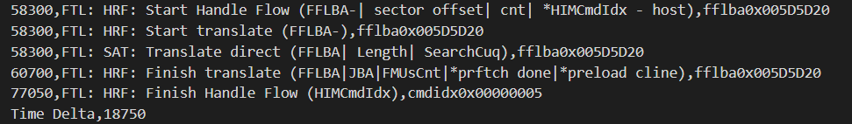
Output: QoS trace
Start event
In between event
Sequential
End event
Time delta, start to end

Slide 16
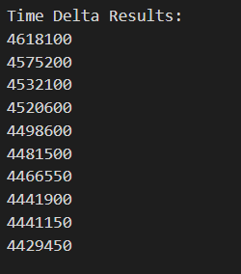
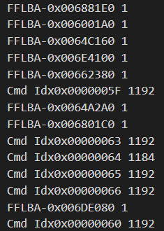
Output: Top Result & Counter
Top 10 Results
Counter of events

Slide 17
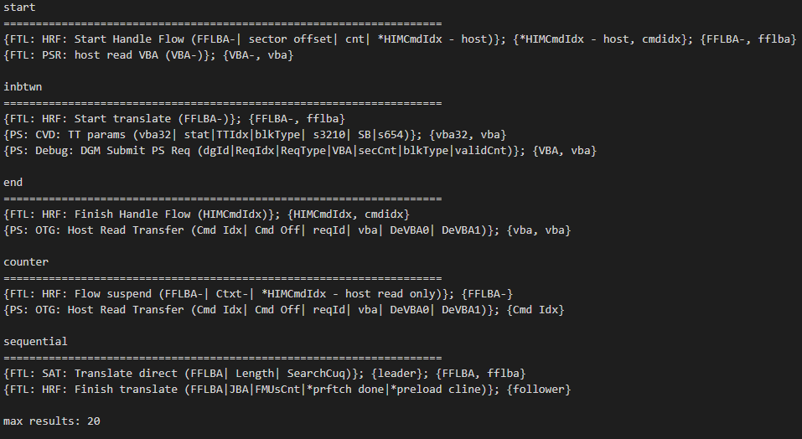
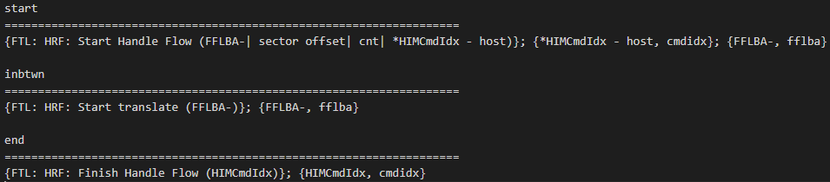

Time & Data metrics
Time
Plugin time
Start, inbtwn, end, counter, sequential: 15.293 secs
Start, inbtwn, end (one): 15.935 secs
Counter: 14.931 secs
Time it takes to generate 100mb RWR files:
1.870 - 2.072 secs
Space
RWR space: 30 min test = ~868 RWR files = ~86 Gbs of data

Slide 18
Q & A

Slide 19
References
Plugin User Manual
https://confluence.wdc.com/display/SWT/Plugin+User+Manual
Recording with Plugin using CLI
https://confluence.wdc.com/pages/viewpage.action?spaceKey=SWT&title=Recording+with+plugin
RWR Plugin Examples
https://confluence.wdc.com/display/SWT/RWR+Plugin+Examples

